Slide 1


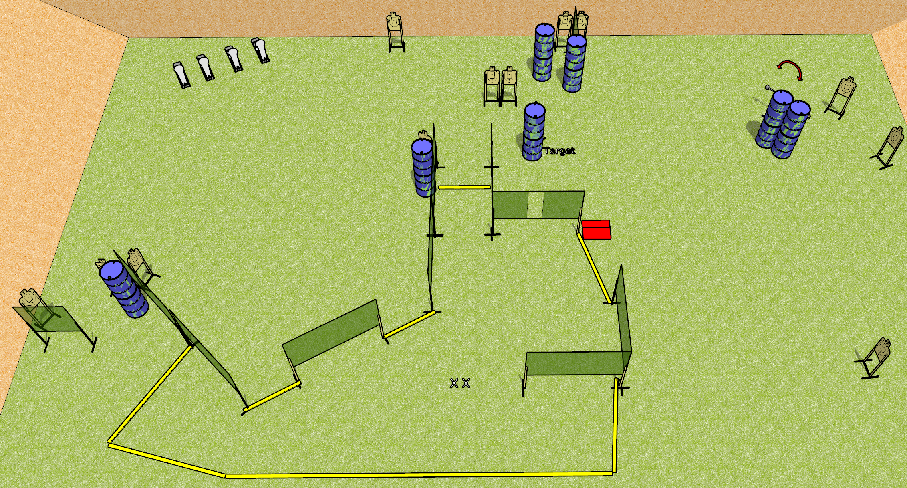
 | Dothan Gun Club – USPSA Match Running Around Course Designer : Drew Coleman
Round Count 32 rounds 14 USPSA 4 colt poppers
Equipment List 3 medium fault lines 18 wall feet Swinger + stomp pad

Slide 2
Running Around
Written Stage Briefing
Running Around is a 32 round, 160 point, Comstock course of the fire. There are 14 USPSA targets and 4 steel. The best 2 hits on cardboard will score and steel must fall to score.
The swinger is activated by the stomp pad and remains visible at rest.
Handgun start position is feet on X’s, wrists below belt. Handgun is loaded and holstered.
PCC start position is feet on X’s, stock on belt. Loaded carbine is held with both hands, safety on.
On the audible start signal, engage targets as they become available from within the shooting area.

